Slide 1


Notes:
A lot has changed over the last 30 years. Have a look at the images on screen of different items and we will ask you to vote for the one that you think is from 30 years ago. You vote through one of the poses shown on the screen. Give an example
If you are not comfortable or not able to get active, you can vote with choosing 1, 2 or 3 instead.

Slide 2
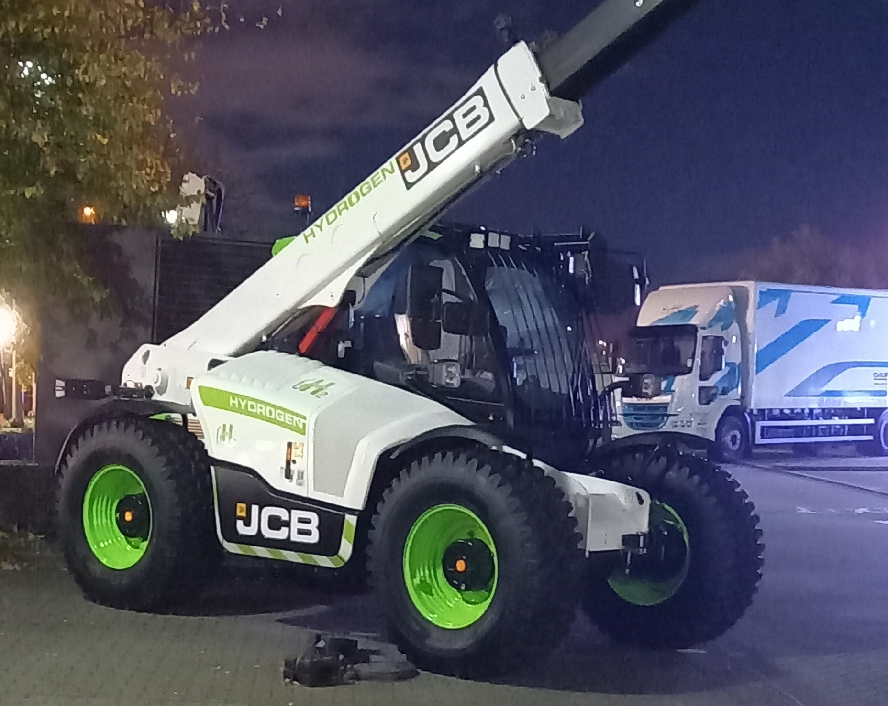
Eisoes yn cael eu cynhyrchu
Cerbydau Hydrogen
Hydrogen Vehicles
Hydrogen Vehicles
Unig wastraff yw dŵr
Cynhyrchu trydan eu hun
7
Cynaladwyedd
Sustainability
Sustainability
7
7
7
6
6
6
Cyflymder
6
Speed
Speed
Tebyg i gerbyd cyffredin
9
9
9
Tebygolrwydd
9
Likelihood
Likelihood
Waw Ffactor
Wow Factor
Wow Factor
Notes:
Efa mentions Hydrogen vehicles existing in the future, but they are already starting to be produced now. They use hydrogen – the most abundant chemical in the universe – as fuel. In the engine the hydrogen is combined with oxygen in the air and the chemical reaction produces electricity to power the vehicle. The only waste product is water! Hydrogen vehicles are great as they create their own electricity, as opposed to electric vehicles which require electricity to be created for them.
As an aside you can get the hydrogen for the fuel from urine, so maybe we’ll be driving wee powered cars in the future!

Slide 3
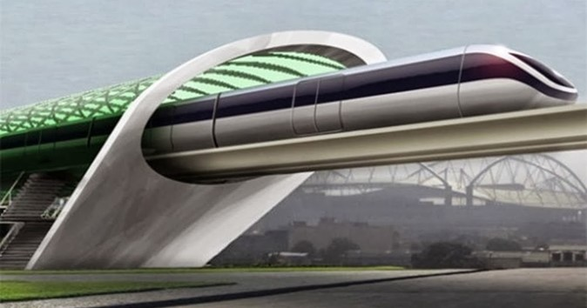
Yr Hyperloop
700 mya
Rhedeg ar fagnedau
Gall fynd danddaearol
Bydd yn defnyddio tanwydd cynaliadwy
Cynaladwyedd
8
Cyflymder
10
Tebygolrwydd
7
Waw Ffactor
Notes:
Efa mentions the Hyperloop in the video. This is a series of tunnels or tubes running all over the world, with pods zooming around inside. The pods will run on magnets and the tubes will be like a vacuum meaning the pods can travel further and faster on less power. The pods could be powered by solar, wind or another sustainable method, and could travel up to 700mph, meaning an end of aeroplanes maybe.
The hyperloop is already being tested today

Slide 4

Eco-Awyrlong
Fel mordaith yn yr awyr
Gall gario 100oedd o bobl
75% llai o allyrion nac awyren
Cynaladwyedd
7
Cyflymder
3
Tebygolrwydd
7
Waw Ffactor
Pyllau nofio
Notes:
Airships being made today produce 75% less emissions that aeroplanes – in the future this amount will be even less if hydrogen fuel is used.
An airship can carry up to 200 people, but in the future could perhaps include swimming pools, gyms… – it’ll be like giant floating hotel taking people across the World

Slide 5
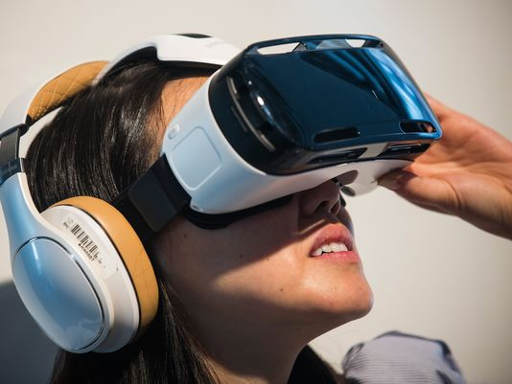
Teithio heb symud
Teithio Rhithwir
Effaith amgylcheddol isel
Eisoes yn bodoli heddiw
Cynaladwyedd
5
Cyflymder
10
Teithio i unrhywle yn y bydysawd
Tebygolrwydd
10
Waw Ffactor
Notes:
Do we actually need to travel anywhere anymore? We’re speaking to schools all across Wales right now! Perhaps virtual worlds will be created which you can attend virtually without leaving your house. Want to go on holiday to Iceland – perhaps you can just visit all the sites virtually. Perhaps there will be a smellovision to bring the smells as well and Icelandic food will be delivered to your door as part of the experience. A good way to travel – what do you think?

Slide 6
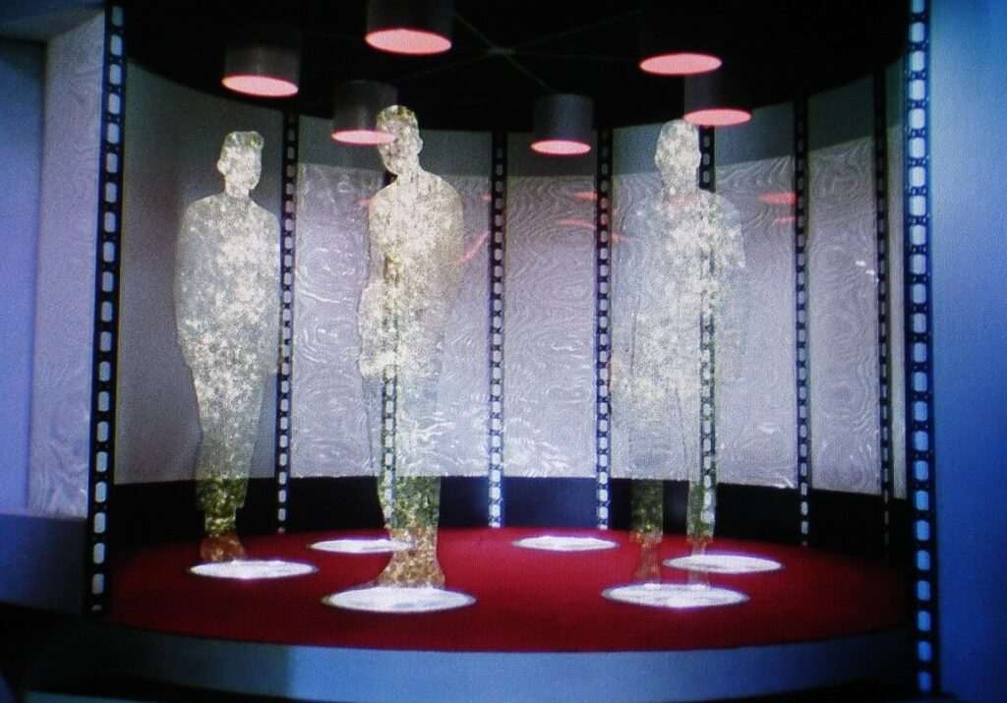
Teleportadu
Teithio ar unwaith
Arbed amser
Bron yn amhosibl
Cynaladwyedd
6
Cyflymder
10
Tebygolrwydd
2
Dim ffyrdd
Waw Ffactor
Notes:
Straight from science fiction right? Maybe not… Scientists have already teleported single particles over 300 miles! Now teleporting a person is a lot harder than a single particle, but who knows what the future holds.

Slide 7
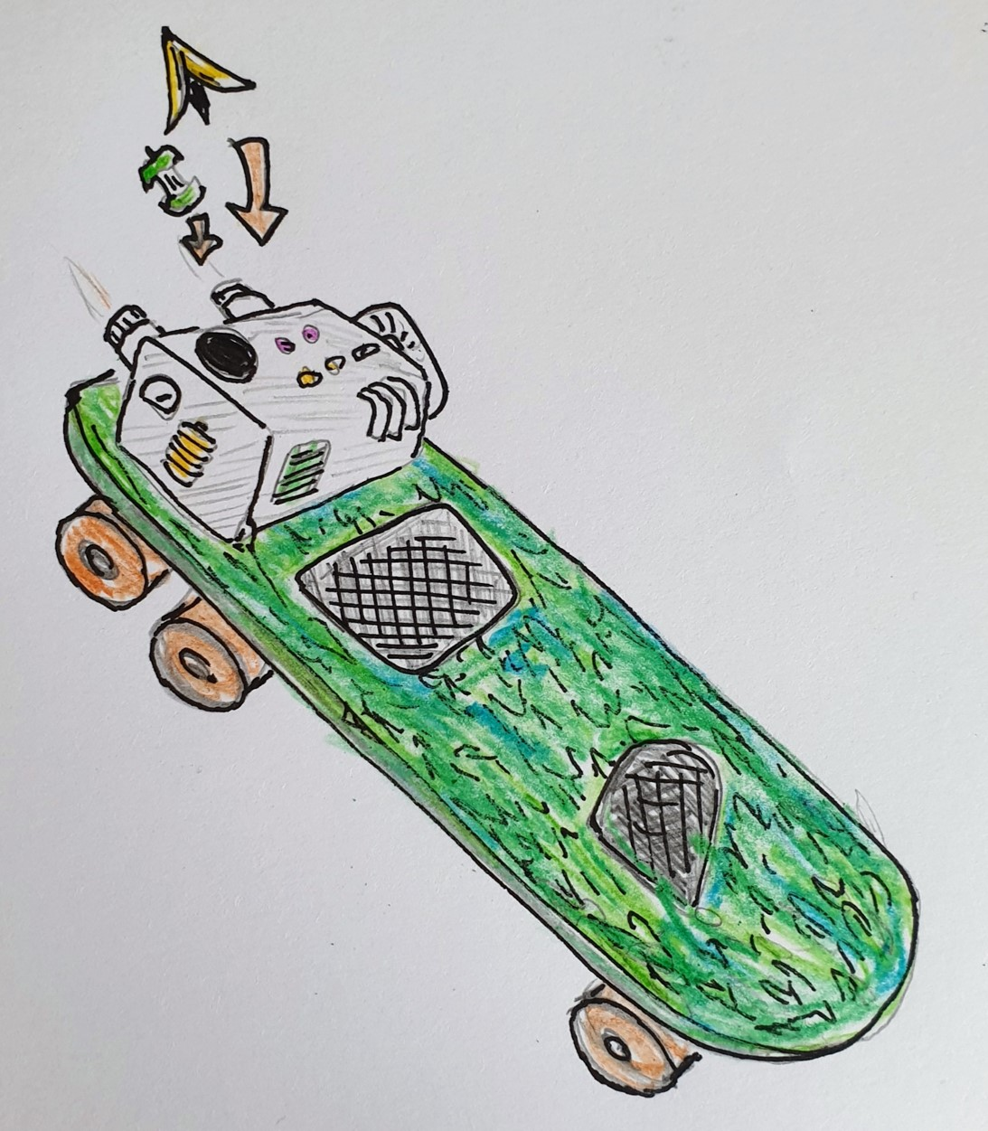
Pweru gan ffotosynthesis
Eco-Sglefrfwrdd
Dim llygredd
Defnyddio fel sglefrfwrdd cyffredin
Cynaladwyedd
9
Cyflymder
3
Tebygolrwydd
2
Cynhyrchu ocsigen
Waw Ffactor
Notes:
If we imagine it, we can work to create it. My idea is a skateboard covered in moss, and small plants, that harnesses the power of photosynthesis to power the board. It also has a small engine that rapidly decomposes apple cores and banana peel to generate electricity to power the board up steep hills. But because active travel is good, you can still use it like a normal skateboard and push it along yourself to stay fit.
Needs a better name though! If anyone can help me come up with one they can have a 50% stake in my company!

Slide 8



